Slide 1


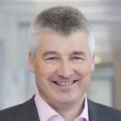
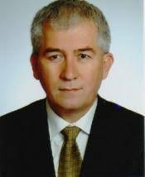

Life Sciences Application and
Research Center
June 8.2021 Tuesday
16.00 - 17.00
Essen
17.00 - 18.00 Ankara
ZOOM
MEETING
INTERNATIONAL SEMINARS ON HEALTH SCIENCE
"How Cells Sense and Adapt to Oxygen Sensitivity"
Nobel Prize in Physiology
or Medicine 2019
MEETING ID: 954 4422 3105
PASSWORD: Gazi1926
Speaker
Prof. Dr. Joachim Fandrey, M.D.
Professor of Physiology
Institute of Physiolog
Medical Faculty - Vice Dean
University of Duisburg-Essen
Moderator
Prof. Dr. Orhan Canbolat, M.D.
Biochemistry Department
Medical Faculty Gazi University,
Life Sciences Application and
Research Center - Director

